Slide 1

MASTER THE TIDYVERSE
Mike K Smith
Winter 2020
Materials used in this course are derived from
https://github.com/rstudio-education/master-the-tidyverse/
and are shared under a CC-BY-SA-4.0 license.

Slide 2


HELLO
my name is
Mike
 @MikeKSmith
MikeKSmith
Mike.K.Smith@Pfizer.com
CC BY-SA RStudio
Notes:
* introduce yourself

Slide 3
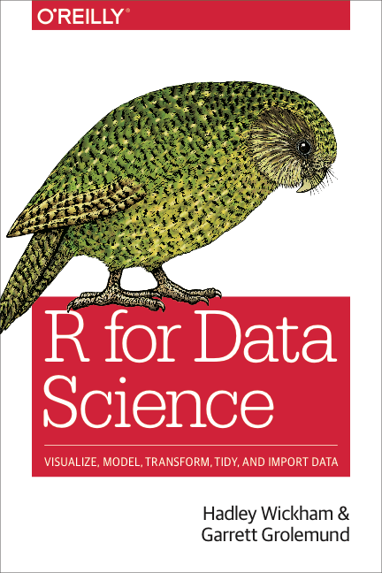
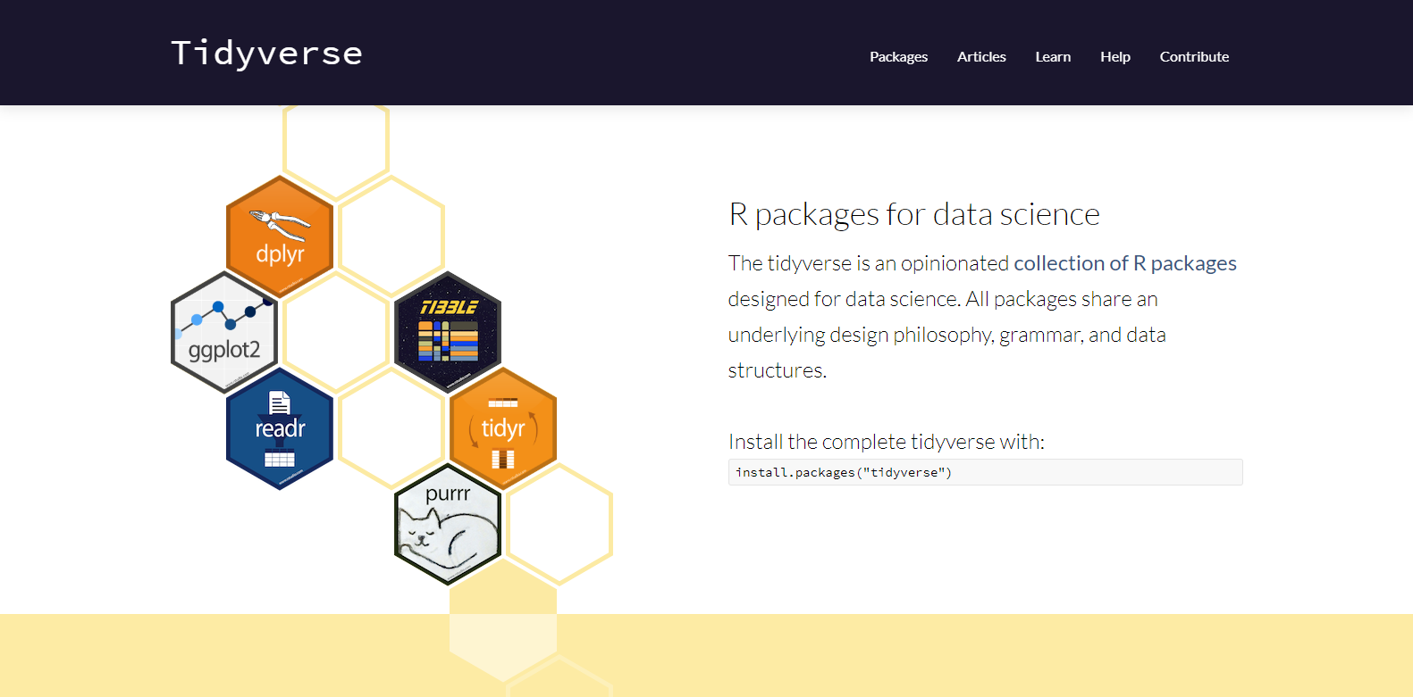
http://tidyverse.org
https://r4ds.had.co.nz/
CC BY-SA RStudio

Slide 4
Introduction and Visualize Data | 17th Jan
Transforming (subsetting) data | 24th Jan
Importing and reshaping data | 31st Jan
Data Types: strings, factors, date-times | 7th Feb
Iteration & Modelling | 14th Feb
Reproducible reporting | 21st Feb
CC BY-SA RStudio

Slide 6

babynames
Names of male and female babies born in the US from 1880 to 2015. 1.8M rows.
R package
# install.packages("babynames")
library(babynames)
CC BY-SA RStudio

Slide 7
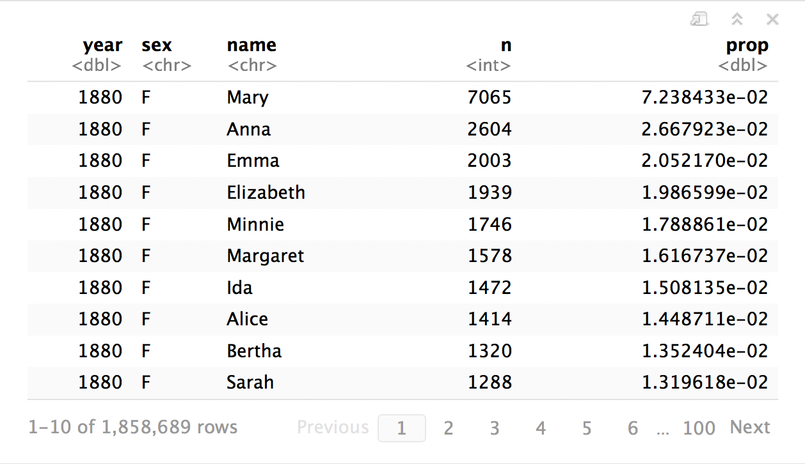
babynames
CC BY-SA RStudio

Slide 8

tibbles

Slide 9


Slide 10
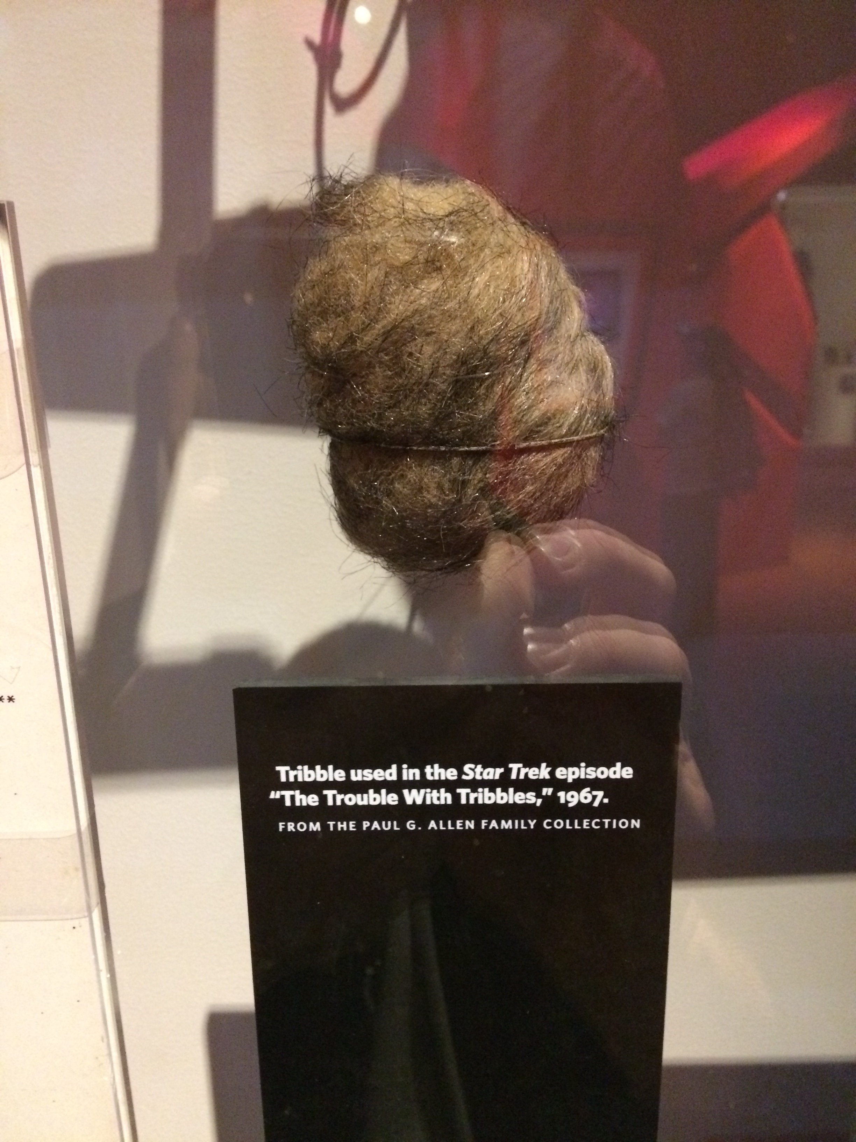

Slide 11
tibbles
A type of data frame common throughout tidyverse packages. Tibbles enhance data frames in three ways:
Display - When you print a tibble, R provides a concise view of the data that fits on one screen
Subsetting - [ always returns a new tibble, [[ and $ always return a new vector
No partial matching - You must use full column names when subsetting
CC BY-SA RStudio

Slide 12
# A tibble: 234 × 6
manufacturer model displ
<chr> <chr> <dbl>
1 audi a4 1.8
2 audi a4 1.8
3 audi a4 2.0
4 audi a4 2.0
5 audi a4 2.8
6 audi a4 2.8
7 audi a4 3.1
8 audi a4 quattro 1.8
9 audi a4 quattro 1.8
10 audi a4 quattro 2.0
# ... with 224 more rows, and 3
# more variables: year <int>,
# cyl <int>, trans <chr>
wind | wind | wind
tibble display
156 1999 6 auto(l4)
157 1999 6 auto(l4)
158 2008 6 auto(l4)
159 2008 8 auto(s4)
160 1999 4 manual(m5)
161 1999 4 auto(l4)
162 2008 4 manual(m5)
163 2008 4 manual(m5)
164 2008 4 auto(l4)
165 2008 4 auto(l4)
166 1999 4 auto(l4)
[ reached getOption("max.print") -- omitted 68 rows ]
A large table to display
data frame display
CC BY-SA RStudio

Slide 13
tibble
R package
A package with several helper functions for tibbles:
as_tibble() - convert a data frame to a tibble
as.data.frame() - convert a tibble to a data frame
tribble() - make a tibble (transversed)
tribble(
~x, ~y,
1, "a",
2, "b",
3, "c")
x | y
1 | a
2 | b
3 | c
CC BY-SA RStudio

Slide 14
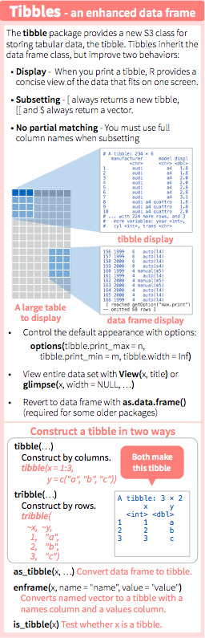
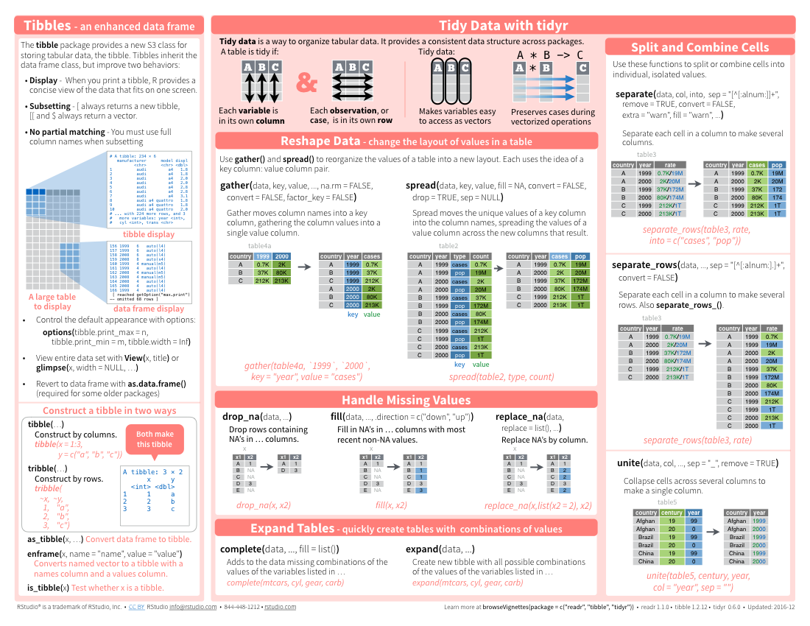
tibbles
CC BY-SA RStudio

Slide 15
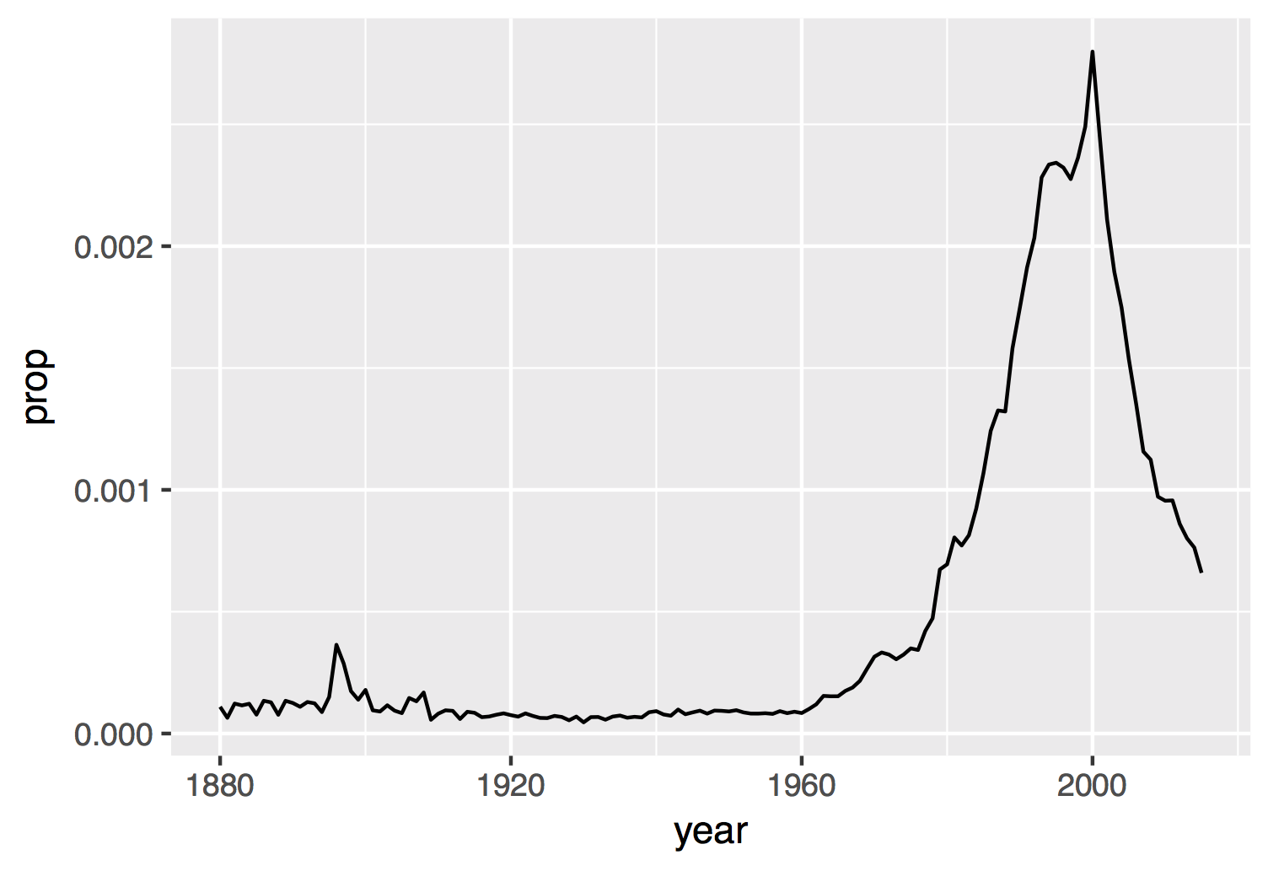
Proportion of boys with the name Garrett
CC BY-SA RStudio

Slide 16
How to isolate?
year | sex | name | n | prop
1880 | M | John | 9655 | 0.0815
1880 | M | William | 9532 | 0.0805
1880 | M | James | 5927 | 0.0501
1880 | M | Charles | 5348 | 0.0451
1880 | M | Garrett | 13 | 0.0001
1881 | M | John | 8769 | 0.081
1881 | M | William | 8524 | 0.0787
1881 | M | James | 5442 | 0.0503
1881 | M | Charles | 4664 | 0.0431
1881 | M | Garrett | 7 | 0.0001
1881 | M | Gideon | 7 | 0.0001
year | sex | name | n | prop
1880 | M | Garrett | 13 | 0.0001
1881 | M | Garrett | 7 | 0.0001
… | … | Garrett | … | …
CC BY-SA RStudio

Slide 17
dplyr

Slide 18
dplyr
A package that transforms data.
dplyr implements a grammar for transforming tabular data.
CC BY-SA RStudio

Slide 19
Isolating data
select() - extract variables
filter() - extract cases
arrange() - reorder cases
CC BY-SA RStudio

Slide 20
select()

Slide 21
select()
Extract columns by name.
select(.data, …)
data frame to transform
name(s) of columns to extract
(or a select helper function)
CC BY-SA RStudio

Slide 22
select()
Extract columns by name.
select(babynames, name, prop)
babynames
year | sex | name | n | prop
1880 | M | John | 9655 | 0.0815
1880 | M | William | 9532 | 0.0805
1880 | M | James | 5927 | 0.0501
1880 | M | Charles | 5348 | 0.0451
1880 | M | Garrett | 13 | 0.0001
1881 | M | John | 8769 | 0.081
1881 | M | William | 8524 | 0.0787
1881 | M | James | 5442 | 0.0503
1881 | M | Charles | 4664 | 0.0431
1881 | M | Garrett | 7 | 0.0001
1881 | M | Gideon | 7 | 0.0001
name | prop
John | 0.0815
William | 0.0805
James | 0.0501
Charles | 0.0451
Garrett | 0.0001
John | 0.081
William | 0.0787
James | 0.0503
Charles | 0.0431
Garrett | 0.0001
Gideon | 0.0001
CC BY-SA RStudio

Slide 23

Your Turn 1
Alter the code to select just the n column:
select(babynames, name, prop)

Slide 24
select(babynames, n)
# n
# <int>
# 1 7065
# 2 2604
# 3 2003
# 4 1939
# 5 1746
# … …
CC BY-SA RStudio

Slide 25
Why not “n”?
select(babynames, "n")
# n
# <int>
# 1 7065
# 2 2604
# 3 2003
# 4 1939
# 5 1746
# … …
Tidy evaluation.

Slide 26
select() helpers
Select range of columns
select(storms, storm:pressure)
Select every column but
select(storms, -c(storm, pressure))
starts_with() - Select columns that start with…
select(storms, starts_with("w"))
ends_with() - Select columns that end with…
select(storms, ends_with("e"))
CC BY-SA RStudio

Slide 27
select() helpers
contains() - Select columns whose names contain…
select(storms, contains("d"))
matches() - Select columns whose names match regular expression
select(storms, matches("^.{4}$"))
one_of() - Select columns whose names are one of a set
select(storms, one_of(c("storm", "storms", "Storm"))
num_range() - Select columns named in prefix, number style
select(storms, num_range("x", 1:5))
CC BY-SA RStudio

Slide 28
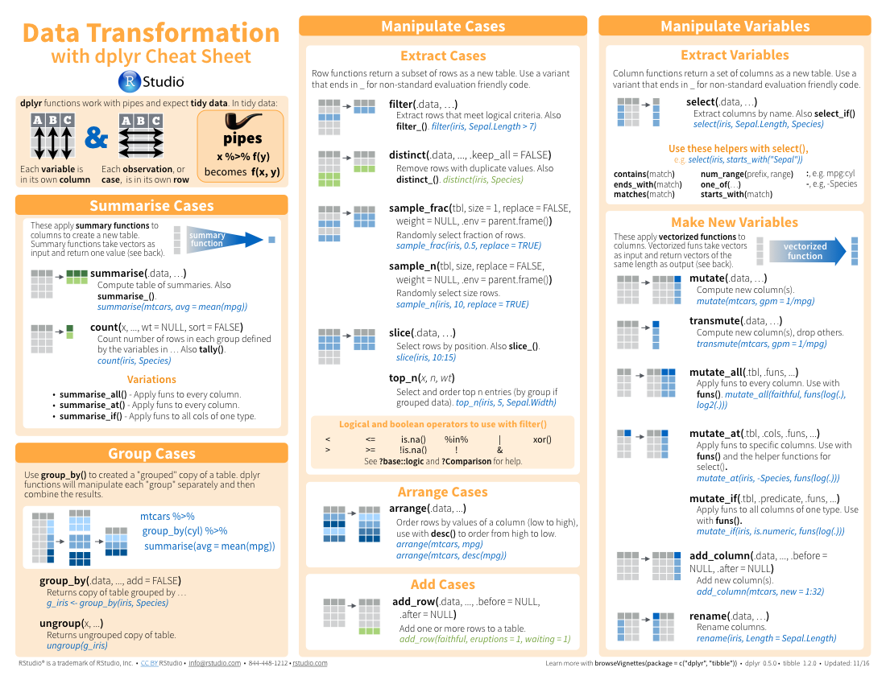
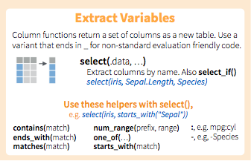
select() helpers
CC BY-SA RStudio

Slide 29
Quiz
Which of these is NOT a way to select the name and n columns together?
select(babynames, -c(year, sex, prop))
select(babynames, name:n)
select(babynames, starts_with("n"))
select(babynames, ends_with("n"))

Slide 30
Quiz
Which of these is NOT a way to select the name and n columns together?
select(babynames, -c(year, sex, prop))
select(babynames, name:n)
select(babynames, starts_with("n"))
select(babynames, ends_with("n"))

Slide 31
Quiz
Will this work?
select(babynames, year:name - prop)

Slide 32
Quiz
Will this work?
select(babynames, year:name - prop)
No. 'select' takes a comma separated list of column names or positions (see help for 'select'):
select(babynames, year:name, -prop)

Slide 33
filter()

Slide 34
filter()
Extract (keep!) rows that meet logical criteria.
filter(.data, … )
data frame to transform
one or more logical tests (filter returns each row for which the test is TRUE)
CC BY-SA RStudio

Slide 35
common syntax
Each function takes a data frame / tibble as its first argument and returns a data frame / tibble.
filter(.data, … )
dplyr function
data frame to transform
Function specific arguments
CC BY-SA RStudio

Slide 36
filter()
Extract rows that meet logical criteria.
filter(babynames, name == "Garrett")
babynames
year | sex | name | n | prop
1880 | M | John | 9655 | 0.0815
1880 | M | William | 9532 | 0.0805
1880 | M | James | 5927 | 0.0501
1880 | M | Charles | 5348 | 0.0451
1880 | M | Garrett | 13 | 0.0001
1881 | M | John | 8769 | 0.081
1881 | M | William | 8524 | 0.0787
1881 | M | James | 5442 | 0.0503
1881 | M | Charles | 4664 | 0.0431
1881 | M | Garrett | 7 | 0.0001
1881 | M | Gideon | 7 | 0.0001
year | sex | name | n | prop
1880 | M | Garrett | 13 | 0.0001
1881 | M | Garrett | 7 | 0.0001
… | … | Garrett | … | …
CC BY-SA RStudio

Slide 37
filter()
Extract rows that meet logical criteria.
filter(babynames, name == "Garrett")
babynames
year | sex | name | n | prop | name == "Garrett"
1880 | M | John | 9655 | 0.0815 | FALSE
1880 | M | William | 9532 | 0.0805 | FALSE
1880 | M | James | 5927 | 0.0501 | FALSE
1880 | M | Charles | 5348 | 0.0451 | FALSE
1880 | M | Garrett | 13 | 0.0001 | TRUE
1881 | M | John | 8769 | 0.081 | FALSE
1881 | M | William | 8524 | 0.0787 | FALSE
1881 | M | James | 5442 | 0.0503 | FALSE
1881 | M | Charles | 4664 | 0.0431 | FALSE
1881 | M | Garrett | 7 | 0.0001
1881 | M | Gideon | 7 | 0.0001 | FALSE
= sets
(returns nothing)
== tests if equal
(returns TRUE or FALSE)
Rows are kept when this predicate is TRUE

Slide 38
Logical tests
?Comparison
x < y | Less than
x > y | Greater than
x == y | Equal to
x <= y | Less than or equal to
x >= y | Greater than or equal to
x != y | Not equal to
x %in% y | Group membership
is.na(x) | Is NA
!is.na(x) | Is not NA
CC BY-SA RStudio

Slide 39
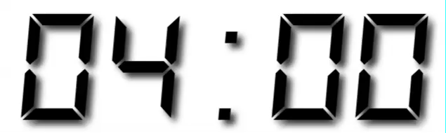
Your Turn 2
See if you can use the logical operators to manipulate our code below to show:
• All of the names where prop is greater than or equal to 0.08
• All of the children named “Sea”
• All of the names that have a missing value for n
(Hint: this should return an empty data set).

Slide 40
filter(babynames, prop >= 0.08)
# year sex name n prop
# 1 1880 M John 9655 0.08154630
# 2 1880 M William 9531 0.08049899
# 3 1881 M John 8769 0.08098299
filter(babynames, name == "Sea")
# year sex name n prop
# 1 1982 F Sea 5 2.756771e-06
# 2 1985 M Sea 6 3.119547e-06
# 3 1986 M Sea 5 2.603512e-06
# 4 1998 F Sea 5 2.580377e-06
filter(babynames, is.na(n))
# 0 rows
CC BY-SA RStudio

Slide 41
Two common mistakes
1. Using = instead of ==
filter(babynames, name = "Sea")
filter(babynames, name == "Sea")
2. Forgetting quotes
filter(babynames, name == Sea)
filter(babynames, name == "Sea")
CC BY-SA RStudio

Slide 42
Two common mistakes
1. Using = instead of ==
filter(babynames, name = "Sea")
filter(babynames, name == "Sea")
in tidyverse: names of columns do not need quotes.
but we're comparing against the contents of a column with type character
2. Forgetting quotes
filter(babynames, name == Sea)
filter(babynames, name == "Sea")
CC BY-SA RStudio

Slide 43
filter()
Extract rows that meet every logical criteria.
filter(babynames, name == "Garrett", year == 1880)
babynames
year | sex | name | n | prop
1880 | M | John | 9655 | 0.0815
1880 | M | William | 9532 | 0.0805
1880 | M | James | 5927 | 0.0501
1880 | M | Charles | 5348 | 0.0451
1880 | M | Garrett | 13 | 0.0001
1881 | M | John | 8769 | 0.081
1881 | M | William | 8524 | 0.0787
1881 | M | James | 5442 | 0.0503
1881 | M | Charles | 4664 | 0.0431
1881 | M | Garrett | 7 | 0.0001
1881 | M | Gideon | 7 | 0.0001
year | sex | name | n | prop
1880 | M | Garrett | 13 | 0.0001
CC BY-SA RStudio

Slide 44
filter()
Equivalent to:
temp <- filter(babynames, name == "Garrett")
filter(temp, year == 1880)
babynames
year | sex | name | n | prop
1880 | M | John | 9655 | 0.0815
1880 | M | William | 9532 | 0.0805
1880 | M | James | 5927 | 0.0501
1880 | M | Charles | 5348 | 0.0451
1880 | M | Garrett | 13 | 0.0001
1881 | M | John | 8769 | 0.081
1881 | M | William | 8524 | 0.0787
1881 | M | James | 5442 | 0.0503
1881 | M | Charles | 4664 | 0.0431
1881 | M | Garrett | 7 | 0.0001
1881 | M | Gideon | 7 | 0.0001
year | sex | name | n | prop
1880 | M | Garrett | 13 | 0.0001
CC BY-SA RStudio

Slide 45
Boolean operators
?base::Logic
a & b | and
a | b | or
xor(a,b) | exactly or
!a | not
CC BY-SA RStudio

Slide 46
filter()
Extract rows that meet every logical criteria.
filter(babynames, name == "Garrett" & year == 1880)
babynames
year | sex | name | n | prop
1880 | M | John | 9655 | 0.0815
1880 | M | William | 9532 | 0.0805
1880 | M | James | 5927 | 0.0501
1880 | M | Charles | 5348 | 0.0451
1880 | M | Garrett | 13 | 0.0001
1881 | M | John | 8769 | 0.081
1881 | M | William | 8524 | 0.0787
1881 | M | James | 5442 | 0.0503
1881 | M | Charles | 4664 | 0.0431
1881 | M | Garrett | 7 | 0.0001
1881 | M | Gideon | 7 | 0.0001
year | sex | name | n | prop
1880 | M | Garrett | 13 | 0.0001
CC BY-SA RStudio

Slide 47
Your Turn 3
Use Boolean operators to alter the code below to return only the rows that contain:
• Girls named Sea
• Names that were used by exactly 5 or 6 children in 1880
• Names that are one of Acura, Lexus, or Yugo
filter(babynames, name == "Sea" | name == "Anemone")

Slide 48
filter(babynames, name == "Sea", sex == "F")
# year sex name n prop
# 1 1982 F Sea 5 2.756771e-06
# 2 1998 F Sea 5 2.580377e-06
filter(babynames, n == 5 | n == 6, year == 1880)
# year sex name n prop
# 1 1880 F Abby 6 6.147289e-05
# 2 1880 F Aileen 6 6.147289e-05
# … … … … … …
filter(babynames, name %in% c("Acura", "Lexus", "Yugo"))
# year sex name n prop
# 1 1990 F Lexus 36 1.752932e-05
# 2 1990 M Lexus 12 5.579156e-06
# … … … … … …
CC BY-SA RStudio

Slide 49
Two more common mistakes
3. Collapsing multiple tests into one
filter(babynames, 10 < n < 20)
filter(babynames, 10 < n, n < 20)
4. Stringing together many tests (when you could use %in%)
filter(babynames, n == 5 | n == 6 | n == 7 | n == 8)
filter(babynames, n %in% c(5, 6, 7, 8))
CC BY-SA RStudio

Slide 50
arrange()

Slide 51
arrange()
Order rows from smallest to largest values.
arrange(.data, …)
data frame to transform
one or more columns to order by
(additional columns will be used as tie breakers)
CC BY-SA RStudio

Slide 52
arrange()
Order rows from smallest to largest values.
arrange(babynames, n)
babynames
year | sex | name | n | prop
1880 | M | John | 9655 | 0.0815
1880 | M | William | 9532 | 0.0805
1880 | M | James | 5927 | 0.0501
1880 | M | Charles | 5348 | 0.0451
1880 | M | Garrett | 13 | 0.0001
1881 | M | John | 8769 | 0.081
1881 | M | William | 8524 | 0.0787
1881 | M | James | 5442 | 0.0503
1881 | M | Charles | 4664 | 0.0431
1881 | M | Garrett | 7 | 0.0001
1881 | M | Gideon | 7 | 0.0001
year | sex | name | n | prop
1880 | M | Garrett | 13 | 0.0001
1880 | M | Charles | 5348 | 0.0451
1880 | M | James | 5927 | 0.0501
1881 | M | John | 8769 | 0.081
1880 | M | William | 9532 | 0.0805
1880 | M | John | 9655 | 0.0815
1881 | M | William | 8524 | 0.0787
1881 | M | James | 5442 | 0.0503
1881 | M | Charles | 4664 | 0.0431
1881 | M | Garrett | 7 | 0.0001
1881 | M | Gideon | 7 | 0.0001
CC BY-SA RStudio

Slide 53
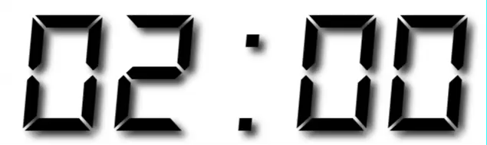
Your Turn 4
Arrange babynames by n. Add prop as a second (tie breaking) variable to arrange on.
Can you tell what the smallest value of n is?

Slide 54
arrange(babynames, n, prop)
# year sex name n prop
# 1 2007 M Aaban 5 2.259872e-06
# 2 2007 M Aareon 5 2.259872e-06
# 3 2007 M Aaris 5 2.259872e-06
# 4 2007 M Abd 5 2.259872e-06
# 5 2007 M Abdulazeez 5 2.259872e-06
# 6 2007 M Abdulhadi 5 2.259872e-06
# 7 2007 M Abdulhamid 5 2.259872e-06
# 8 2007 M Abdulkadir 5 2.259872e-06
# 9 2007 M Abdulraheem 5 2.259872e-06
# 10 2007 M Abdulrahim 5 2.259872e-06
# ... with 1,858,679 more rows
CC BY-SA RStudio

Slide 55
desc()
Changes ordering to largest to smallest.
arrange(babynames, desc(n))
babynames
year | sex | name | n | prop
1880 | M | John | 9655 | 0.0815
1880 | M | William | 9532 | 0.0805
1880 | M | James | 5927 | 0.0501
1880 | M | Charles | 5348 | 0.0451
1880 | M | Garrett | 13 | 0.0001
1881 | M | John | 8769 | 0.081
1881 | M | William | 8524 | 0.0787
1881 | M | James | 5442 | 0.0503
1881 | M | Charles | 4664 | 0.0431
1881 | M | Garrett | 7 | 0.0001
1881 | M | Gideon | 7 | 0.0001
year | sex | name | n | prop
1880 | M | John | 9655 | 0.0815
1880 | M | William | 9532 | 0.0805
1881 | M | John | 8769 | 0.081
1880 | M | James | 5927 | 0.0501
1880 | M | Charles | 5348 | 0.0451
1880 | M | Garrett | 13 | 0.0001
1881 | M | William | 8524 | 0.0787
1881 | M | James | 5442 | 0.0503
1881 | M | Charles | 4664 | 0.0431
1881 | M | Garrett | 7 | 0.0001
1881 | M | Gideon | 7 | 0.0001
CC BY-SA RStudio

Slide 56
Your Turn 5
Use desc() to find the names with the highest prop.
Then, use desc() to find the names with the highest n.

Slide 57
arrange(babynames, desc(prop))
# year sex name n prop
# 1 1880 M John 9655 0.08154630
# 2 1881 M John 8769 0.08098299
# 3 1880 M William 9531 0.08049899
# 4 1883 M John 8894 0.07907324
# 5 1881 M William 8524 0.07872038
# 6 1882 M John 9557 0.07831617
# 7 1884 M John 9388 0.07648751
# 8 1882 M William 9298 0.07619375
# 9 1886 M John 9026 0.07582198
# 10 1885 M John 8756 0.07551791
# ... with 1,858,679 more rows
arrange(babynames, desc(n))
# year sex name n prop
# 1 1947 F Linda 99680 0.05483609
# 2 1948 F Linda 96211 0.05521159
# 3 1947 M James 94763 0.05102057
# 4 1957 M Michael 92726 0.04238659
# 5 1947 M Robert 91646 0.04934237
# 6 1949 F Linda 91010 0.05184281
# 7 1956 M Michael 90623 0.04225479
# 8 1958 M Michael 90517 0.04203881
# 9 1948 M James 88588 0.04969679
# 10 1954 M Michael 88493 0.04279403
# ... with 1,858,679 more rows
CC BY-SA RStudio

Slide 58
%>%

Slide 59
Steps
boys_2015 <- filter(babynames, year == 2015, sex == "M")
boys_2015 <- select(boys_2015, name, n)
boys_2015 <- arrange(boys_2015, desc(n))
boys_2015
1. Filter babynames to just boys born in 2015
2. Select the name and n columns from the result
3. Arrange those columns so that the most popular names appear near the top.
CC BY-SA RStudio

Slide 60
Steps
boys_2015 <- filter(babynames, year == 2015, sex == "M")
boys_2015 <- select(boys_2015, name, n)
boys_2015 <- arrange(boys_2015, desc(n))
boys_2015
CC BY-SA RStudio

Slide 61
Steps
arrange(select(filter(babynames, year == 2015,
sex == "M"), name, n), desc(n))
CC BY-SA RStudio

Slide 62
The pipe operator %>%
%>%
babynames filter( , n == 99680)
Passes result on left into first argument of function on right. So, for example, these do the same thing. Try it
filter(babynames, n == 99680)
babynames %>% filter(n == 99680)
CC BY-SA RStudio

Slide 63
Pipes
boys_2015 <- filter(babynames, year == 2015, sex == "M")
boys_2015 <- select(boys_2015, name, n)
boys_2015 <- arrange(boys_2015, desc(n))
boys_2015
babynames %>%
filter(year == 2015, sex == "M") %>%
select(name, n) %>%
arrange(desc(n))
CC BY-SA RStudio

Slide 64
foo_foo <- little_bunny()
foo_foo %>%
hop_through(forest) %>%
scoop_up(field_mouse) %>%
bop_on(head)
vs.
foo_foo2 <- hop_through(foo_foo, forest)
foo_foo3 <- scoop_up(foo_foo2, field_mouse)
bop_on(foo_foo3, head)
CC BY-SA RStudio

Slide 65

magrittr

Slide 66

https://en.wikipedia.org/wiki/The_Treachery_of_Images

Slide 67
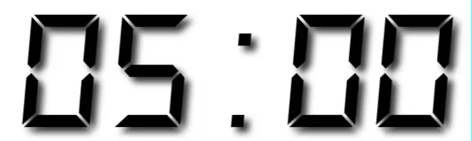
Your Turn 6
Use %>% to write a sequence of functions that:
Filter babynames to just the girls that were born in 2015
Select the name and n columns
Arrange the results so that the most popular names are near the top.

Slide 68
babynames %>%
filter(year == 2015, sex == "F") %>%
select(name, n) %>%
arrange(desc(n))
# name n
# 1 Emma 20355
# 2 Olivia 19553
# 3 Sophia 17327
# 4 Ava 16286
# 5 Isabella 15504
# 6 Mia 14820
# 7 Abigail 12311
# 8 Emily 11727
# 9 Charlotte 11332
# 10 Harper 10241
# ... with 18,983 more rows
CC BY-SA RStudio

Slide 69
Check your understanding
Trim babynames to just the rows that contain your name and your sex
Trim the result to just the columns that will appear in your graph (not strictly necessary, but useful practice)
Plot the results as a line graph with year on the x axis and prop on the y axis

Slide 70

babynames %>%
filter(name == "Garrett", sex == "M") %>%
select(year, prop) %>%
ggplot() +
geom_line(mapping = aes(year, prop))
CC BY-SA RStudio

Slide 71
What are the most popular names?

Slide 72
How should we define popularity?
A name is popular if:
Sums - a large number of children have the name when you sum across years
Ranks - it consistently ranks among the top names from year to year.
CC BY-SA RStudio

Slide 73
How should we define popularity?
A name is popular if:
Sums - a large number of children have the name when you sum across years
Ranks - it consistently ranks among the top names from year to year.
CC BY-SA RStudio

Slide 74
How should we define popularity?
A name is popular if:
Sums - a large number of children have the name when you sum across years
Ranks - it consistently ranks among the top names from year to year.
CC BY-SA RStudio

Slide 75
Quiz
Do we have enough information to:
Calculate the total number of children with each name?
Rank names within each year?

Slide 76
Deriving information
summarise() - summarise variables
group_by() - group cases
mutate() - create new variables
CC BY-SA RStudio

Slide 77
summarise()

Slide 78
summarise()
Compute table of summaries.
babynames %>% summarise(total = sum(n), max = max(n))
babynames
year | sex | name | n | prop
1880 | M | John | 9655 | 0.0815
1880 | M | William | 9532 | 0.0805
1880 | M | James | 5927 | 0.0501
1880 | M | Charles | 5348 | 0.0451
1880 | M | Garrett | 13 | 0.0001
1881 | M | John | 8769 | 0.081
1881 | M | William | 8524 | 0.0787
1881 | M | James | 5442 | 0.0503
1881 | M | Charles | 4664 | 0.0431
1881 | M | Garrett | 7 | 0.0001
1881 | M | Gideon | 7 | 0.0001
total | max
127538 | 99680
CC BY-SA RStudio

Slide 79
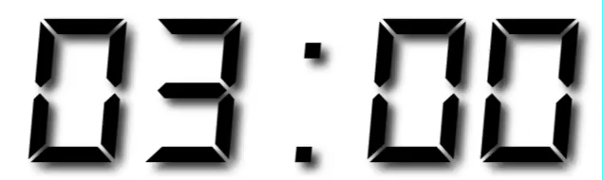
Your Turn 7
Use summarise() to compute three statistics about the data:
The first (minimum) year in the dataset
The last (maximum) year in the dataset
The total number of children represented in the data

Slide 80
babynames %>%
summarise(first = min(year),
last = max(year),
total = sum(n))
# first last total
# 1 1880 2015 340851912
CC BY-SA RStudio

Slide 81
Your Turn 8
Extract the rows where name == "Khaleesi". Then use summarise() and a summary functions to find:
The total number of children named Khaleesi
The first year Khaleesi appeared in the data

Slide 82
babynames %>%
filter(name == "Khaleesi") %>%
summarise(total = sum(n), first = min(year))
# total first
# 1 1127 2011
CC BY-SA RStudio

Slide 83
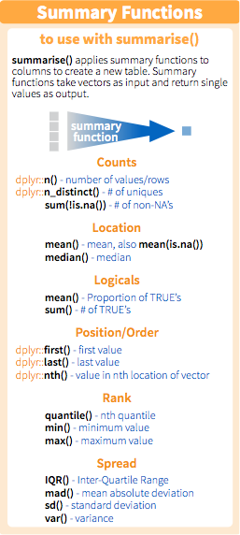
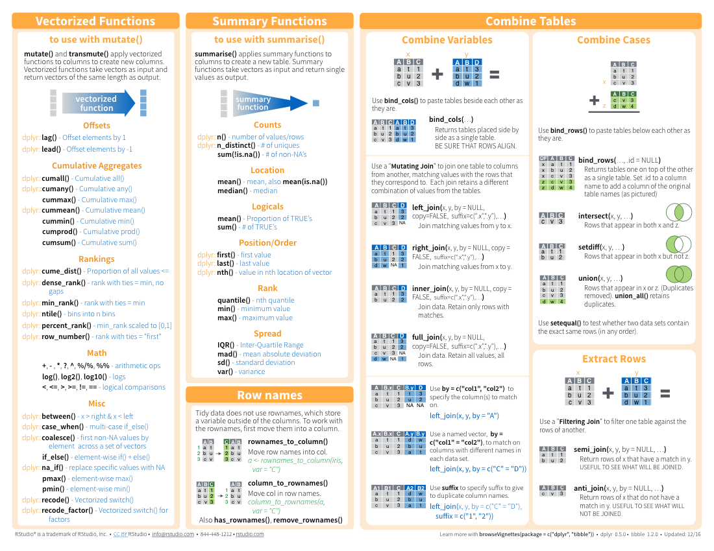
Summary functions
Take a vector as input.
Return a single value as output.
CC BY-SA RStudio

Slide 84
n()
The number of rows in a dataset/group
babynames %>% summarise(n = n())
babynames
year | sex | name | n | prop
1880 | M | John | 9655 | 0.0815
1880 | M | William | 9532 | 0.0805
1880 | M | James | 5927 | 0.0501
1880 | M | Charles | 5348 | 0.0451
1880 | M | Garrett | 13 | 0.0001
1881 | M | John | 8769 | 0.081
1881 | M | William | 8524 | 0.0787
1881 | M | James | 5442 | 0.0503
1881 | M | Charles | 4664 | 0.0431
1881 | M | Garrett | 7 | 0.0001
1881 | M | Gideon | 7 | 0.0001
n
1858689
CC BY-SA RStudio

Slide 85
n_distinct()
The number of distinct values in a variable
babynames %>% summarise(n = n(), nname = n_distinct(name))
babynames
year | sex | name | n | prop
1880 | M | John | 9655 | 0.0815
1880 | M | William | 9532 | 0.0805
1880 | M | James | 5927 | 0.0501
1880 | M | Charles | 5348 | 0.0451
1880 | M | Garrett | 13 | 0.0001
1881 | M | John | 8769 | 0.081
1881 | M | William | 8524 | 0.0787
1881 | M | James | 5442 | 0.0503
1881 | M | Charles | 4664 | 0.0431
1881 | M | Garrett | 7 | 0.0001
1881 | M | Gideon | 7 | 0.0001
n | nname
1858689 | 95025
CC BY-SA RStudio

Slide 86
Grouping
cases

Slide 87
group_by()
Groups cases by common values of one or more columns.
babynames %>%
group_by(sex)
babynames %>% group_by(sex)
Source: local data frame [1,825,433 x 5]
Groups: sex [2]
year sex name n prop
<dbl> <chr> <chr> <int> <dbl>
1 1880 F Mary 7065 0.07238359
2 1880 F Anna 2604 0.02667896
3 1880 F Emma 2003 0.02052149
4 1880 F Elizabeth 1939 0.01986579
5 1880 F Minnie 1746 0.01788843
6 1880 F Margaret 1578 0.01616720
7 1880 F Ida 1472 0.01508119
8 1880 F Alice 1414 0.01448696
9 1880 F Bertha 1320 0.01352390
10 1880 F Sarah 1288 0.01319605
# ... with 1,825,423 more rows
CC BY-SA RStudio

Slide 88
group_by()
Groups cases by common values.
babynames %>%
group_by(sex) %>%
summarise(total = sum(n))
sex | total
F | 167070477
M | 170064949
CC BY-SA RStudio

Slide 89
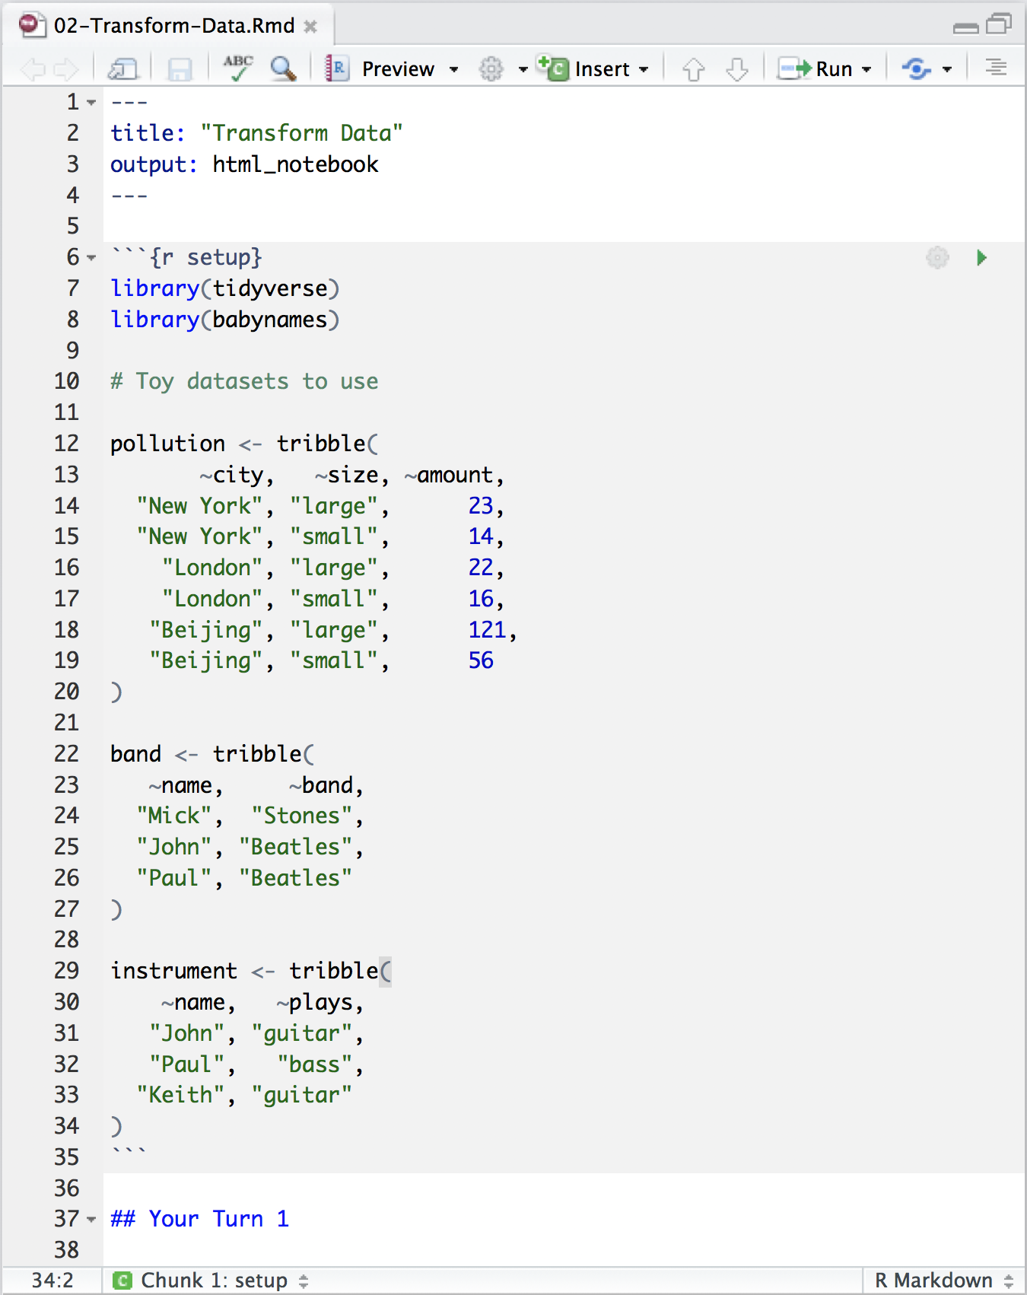
Transform Data Notebook
Toy data sets to practice with
CC BY-SA RStudio

Slide 90
pollution
city | particle size | amount (µg/m³)
New York | large | 23
New York | small | 14
London | large | 22
London | small | 16
Beijing | large | 121
Beijing | small | 56
CC BY-SA RStudio

Slide 91
city | particle size | amount (µg/m³)
New York | large | 23
New York | small | 14
London | large | 22
London | small | 16
Beijing | large | 121
Beijing | small | 56
mean | sum | n
42 | 252 | 6
pollution %>%
summarise(mean = mean(amount), sum = sum(amount), n = n())
CC BY-SA RStudio

Slide 92
city | particle size | amount (µg/m³)
New York | large | 23
New York | small | 14
London | large | 22
London | small | 16
Beijing | large | 121
Beijing | small | 56
mean | sum | n
42 | 252 | 6
CC BY-SA RStudio

Slide 93
city | particle size | amount (µg/m³)
New York | large | 23
New York | small | 14
mean | sum | n
42 | 252 | 6
London | large | 22
London | small | 16
Beijing | large | 121
Beijing | small | 56
CC BY-SA RStudio

Slide 94
city | particle size | amount (µg/m³)
New York | large | 23
New York | small | 14
mean | sum | n
18.5 | 37 | 2
mean | sum | n
18.5 | 37 | 2
London | large | 22
London | small | 16
19.0 | 38 | 2
19.0 | 38 | 2
Beijing | large | 121
Beijing | small | 56
88.5 | 177 | 2
88.5 | 177 | 2
group_by() + summarise()
CC BY-SA RStudio

Slide 95
group_by()
city | particle size | amount (µg/m³)
New York | large | 23
New York | small | 14
city | particle size | amount (µg/m³)
New York | large | 23
New York | small | 14
city | mean | sum | n
New York | 18.5 | 37 | 2
London | 19.0 | 38 | 2
Beijing | 88.5 | 177 | 2
London | large | 22
London | small | 16
London | large | 22
London | small | 16
Beijing | large | 121
Beijing | small | 56
Beijing | large | 121
Beijing | small | 56
pollution %>%
group_by(city) %>%
summarise(mean = mean(amount), sum = sum(amount), n = n())
CC BY-SA RStudio

Slide 96
Your Turn 9
Use group_by(), summarise(), and arrange() to display the ten most popular names. Compute popularity as the total number of children of a single gender given a name.

Slide 97
babynames %>%
group_by(name, sex) %>%
summarise(total = sum(n)) %>%
arrange(desc(total))
# name sex total
# 1 James M 5120990
# 2 John M 5095674
# 3 Robert M 4803068
# 4 Michael M 4323928
# 5 Mary F 4118058
# 6 William M 4071645
# 7 David M 3589754
# 8 Joseph M 2581785
# 9 Richard M 2558165
# 10 Charles M 2371621
# ... with 105,376 more rows
CC BY-SA RStudio

Slide 98
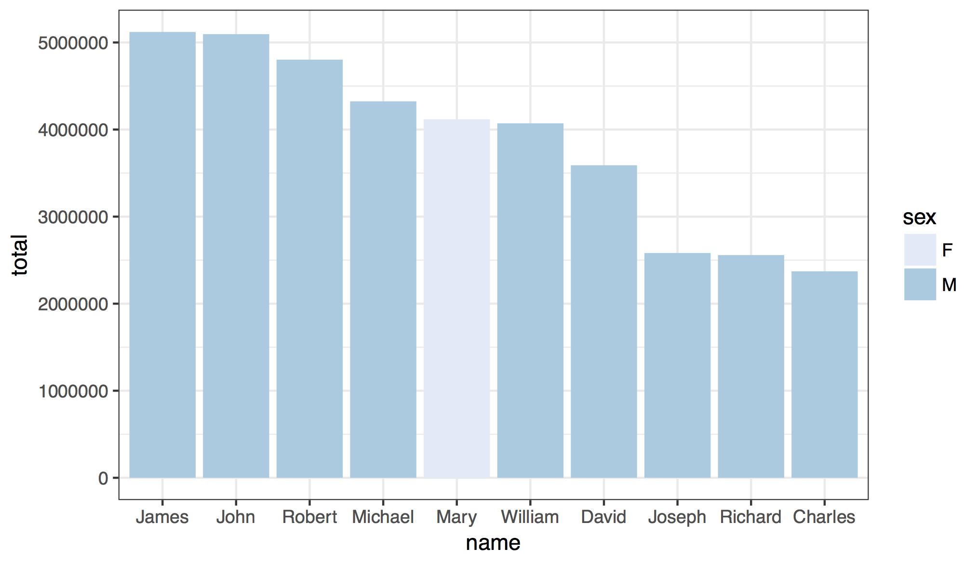
CC BY-SA RStudio

Slide 99
babynames %>%
group_by(name, sex) %>%
summarise(total = sum(n)) %>%
arrange(desc(total)) %>%
ungroup() %>%
slice(1:10) %>%
ggplot() +
geom_col(mapping = aes(x = fct_reorder(name, desc(total)), y = total, fill = sex)) +
theme_bw() +
scale_fill_brewer() +
labs(x = "name")
CC BY-SA RStudio

Slide 100
Your Turn 10
Use grouping to calculate and then plot the number of children born each year over time.

Slide 101
babynames %>%
group_by(year) %>%
summarise(n_children = sum(n)) %>%
ggplot() +
geom_line(mapping = aes(x = year, y = n_children))
CC BY-SA RStudio

Slide 102
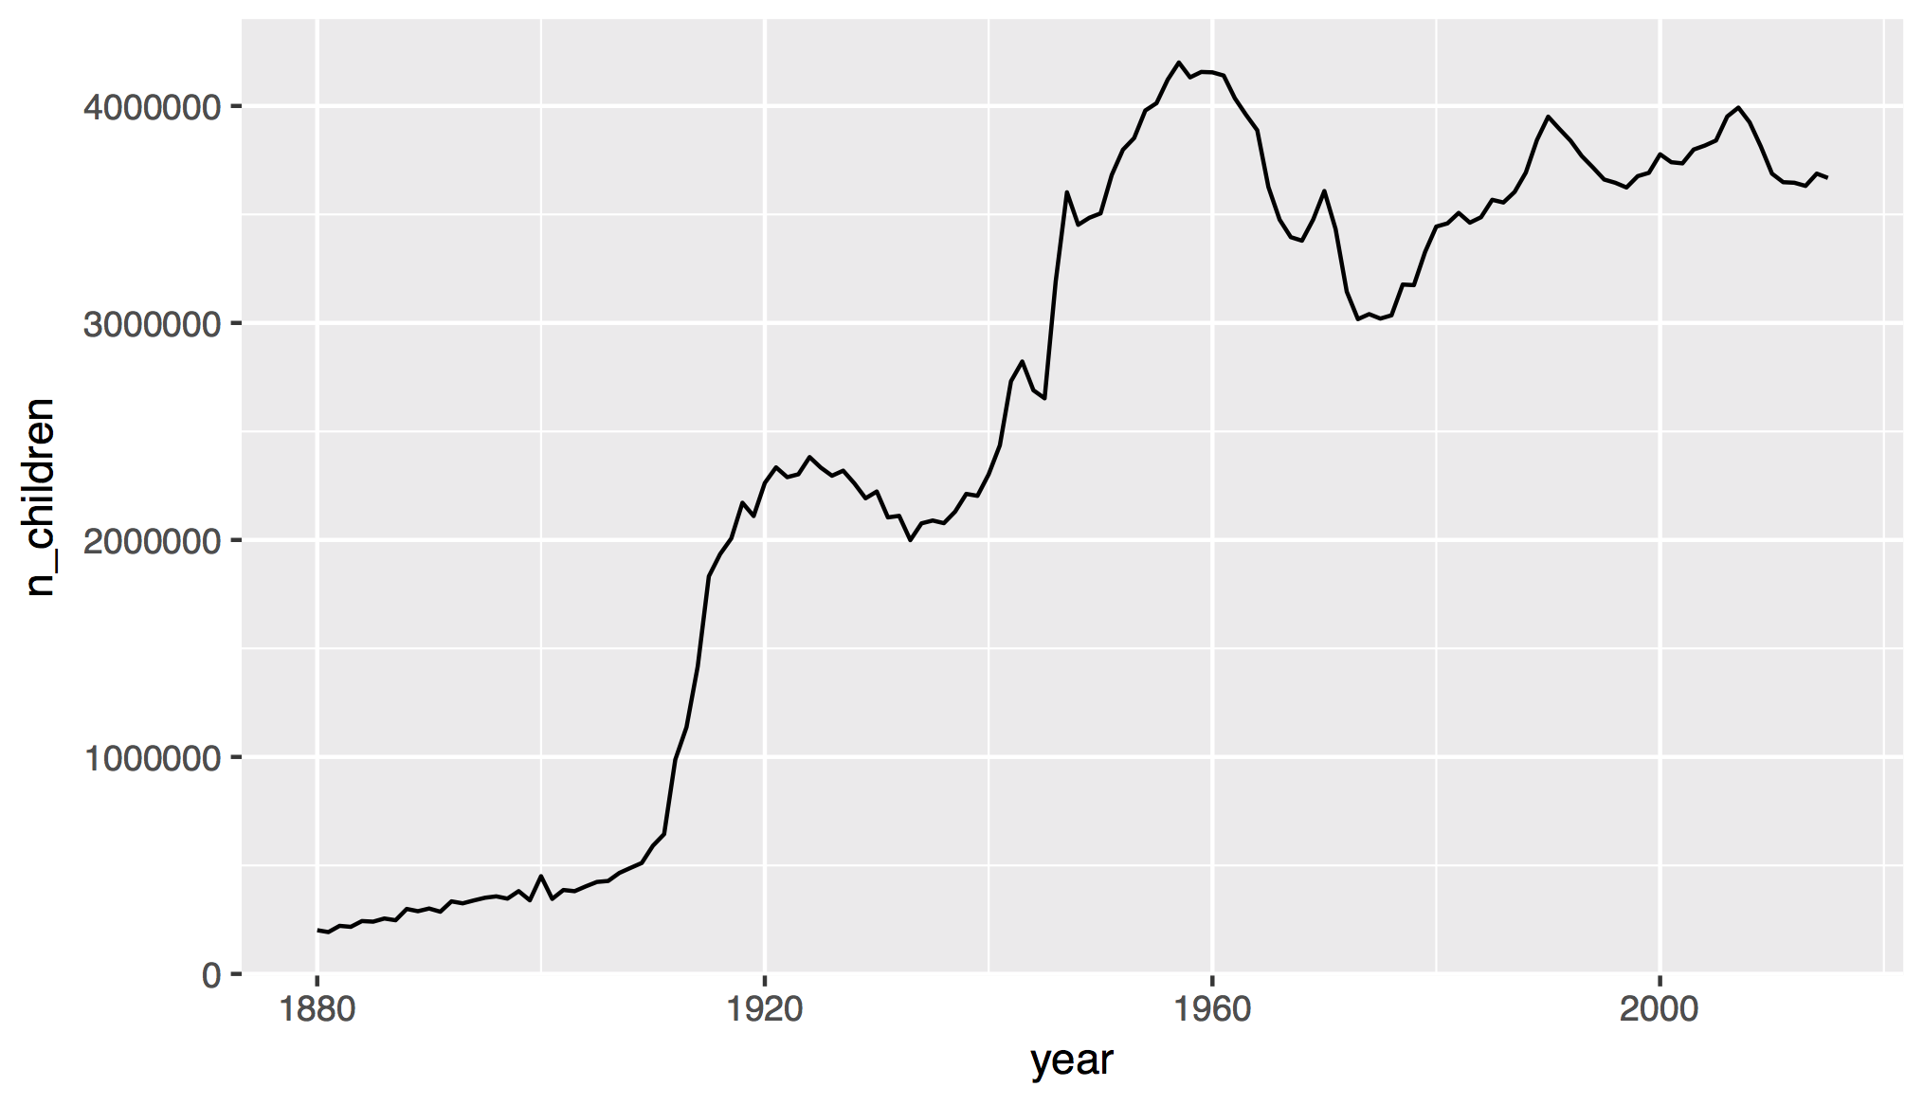
How does this affect our measure of popularity?
CC BY-SA RStudio

Slide 103
ungroup()
Removes grouping criteria from a data frame.
babynames %>%
group_by(name, sex) %>%
summarise(total = sum(n)) %>%
arrange(desc(total))
# name sex total
# 1 James M 5120990
# 2 John M 5095674
# 3 Robert M 4803068
# 4 Michael M 4323928
# 5 Mary F 4118058
# 6 William M 4071645
# 7 David M 3589754
CC BY-SA RStudio

Slide 104
ungroup()
Removes grouping criteria from a data frame.
babynames %>%
group_by(name, sex) %>%
ungroup() %>%
summarise(total = sum(n)) %>%
arrange(desc(total))
# total
# 1 340851912
CC BY-SA RStudio

Slide 105
mutate()

Slide 106
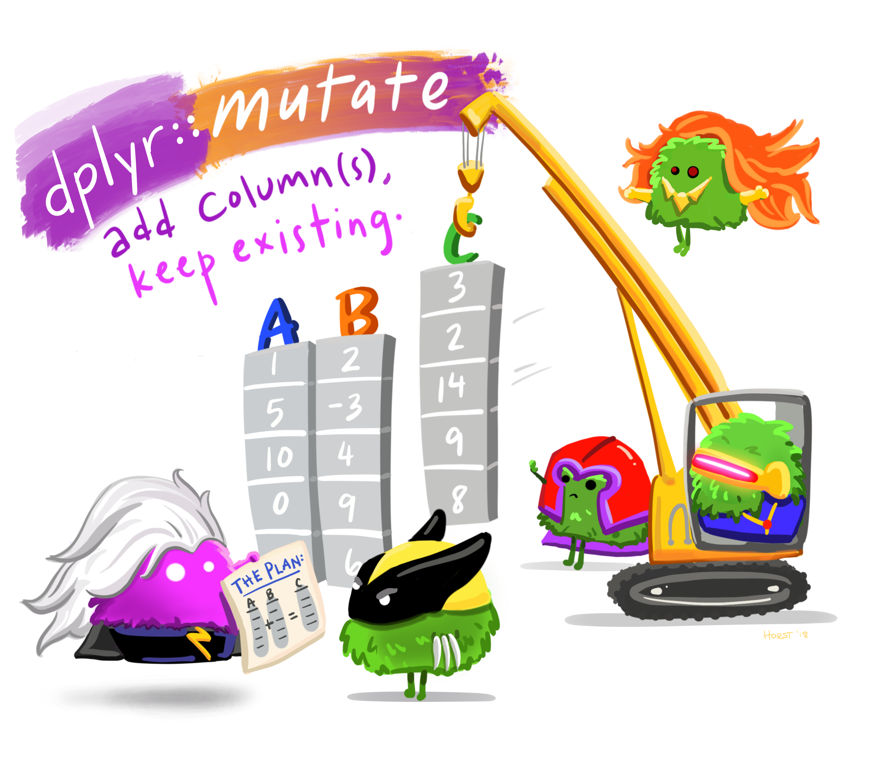

Slide 107
mutate()
Create new columns.
babynames %>%
mutate(percent = round(prop*100, 2))
babynames
year | sex | name | n | prop
1880 | M | John | 9655 | 0.0815
1880 | M | William | 9532 | 0.0805
1880 | M | James | 5927 | 0.0501
1880 | M | Charles | 5348 | 0.0451
1880 | M | Garrett | 13 | 0.0001
1881 | M | John | 8769 | 0.081
1881 | M | William | 8524 | 0.0787
1881 | M | James | 5442 | 0.0503
1881 | M | Charles | 4664 | 0.0431
1881 | M | Garrett | 7 | 0.0001
1881 | M | Gideon | 7 | 0.0001
year | sex | name | n | prop | percent
1880 | M | John | 9655 | 0.0815 | 8.15
1880 | M | William | 9532 | 0.0805 | 8.05
1880 | M | James | 5927 | 0.0501 | 5.01
1880 | M | Charles | 5348 | 0.0451 | 4.51
1880 | M | Garrett | 13 | 0.0001 | 0.01
1881 | M | John | 8769 | 0.081 | 8.1
1881 | M | William | 8524 | 0.0787 | ratio
1881 | M | James | 5442 | 0.0503 | 9.15
1881 | M | Charles | 4664 | 0.0431 | 22.42
1881 | M | Garrett | 7 | 0.0001 | 15.46
1881 | M | Gideon | 7 | 0.0001 | 25.32
CC BY-SA RStudio

Slide 108
mutate()
Create new columns.
babynames %>%
mutate(percent = round(prop*100, 2), nper = round(percent))
babynames
year | sex | name | n | prop
1880 | M | John | 9655 | 0.0815
1880 | M | William | 9532 | 0.0805
1880 | M | James | 5927 | 0.0501
1880 | M | Charles | 5348 | 0.0451
1880 | M | Garrett | 13 | 0.0001
1881 | M | John | 8769 | 0.081
1881 | M | William | 8524 | 0.0787
1881 | M | James | 5442 | 0.0503
1881 | M | Charles | 4664 | 0.0431
1881 | M | Garrett | 7 | 0.0001
1881 | M | Gideon | 7 | 0.0001
year | sex | name | n | prop | percent | nper
1880 | M | John | 9655 | 0.0815 | 8.15 | 8
1880 | M | William | 9532 | 0.0805 | 8.05 | 8
1880 | M | James | 5927 | 0.0501 | 5.01 | 5
1880 | M | Charles | 5348 | 0.0451 | 4.51 | 5
1880 | M | Garrett | 13 | 0.0001 | 0.01 | 0
1881 | M | John | 8769 | 0.081 | 8.1 | 8
1881 | M | William | 8524 | 0.0787 | ratio
1881 | M | James | 5442 | 0.0503 | 9.15
1881 | M | Charles | 4664 | 0.0431 | 22.42
1881 | M | Garrett | 7 | 0.0001 | 15.46
1881 | M | Gideon | 7 | 0.0001 | 25.32
CC BY-SA RStudio

Slide 109
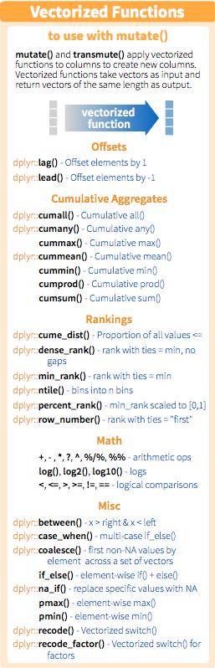
Vectorized functions
Take a vector as input.
Return a vector of the same length as output.
CC BY-SA RStudio

Slide 110
min_rank()
A go to ranking function (ties share the lowest rank)
min_rank(c(50, 100, 1000))
# [1] 1 2 3
min_rank(desc(c(50, 100, 1000)))
# [1] 3 2 1
CC BY-SA RStudio

Slide 111
Your Turn 11
Use min_rank() and mutate() to rank each row in babynames from largest n to lowest n.

Slide 112
babynames %>%
mutate(rank = min_rank(desc(prop)))
# year sex name n prop rank
# 1 1880 F Mary 7065 0.07238433 14
# 2 1880 F Anna 2604 0.02667923 709
# 3 1880 F Emma 2003 0.02052170 1131
# 4 1880 F Elizabeth 1939 0.01986599 1192
# 5 1880 F Minnie 1746 0.01788861 1427
# 6 1880 F Margaret 1578 0.01616737 1683
# 7 1880 F Ida 1472 0.01508135 1897
# 8 1880 F Alice 1414 0.01448711 2040
# 9 1880 F Bertha 1320 0.01352404 2279
# 10 1880 F Sarah 1288 0.01319618 2387
# ... with 1,858,679 more rows
CC BY-SA RStudio

Slide 113
Your Turn 12
Compute each name's rank within its year and sex.
Then compute the median rank for each combination of name and sex, and arrange the results from highest median rank to lowest.

Slide 114
babynames %>%
group_by(year, sex) %>%
mutate(rank = min_rank(desc(prop))) %>%
group_by(name, sex) %>%
summarise(score = median(rank)) %>%
arrange(score)
# name sex score
# 1 Mary F 1
# 2 James M 3
# 3 John M 3
# 4 William M 4
# 5 Robert M 6
# ... with 105,381 more rows
CC BY-SA RStudio

Slide 115
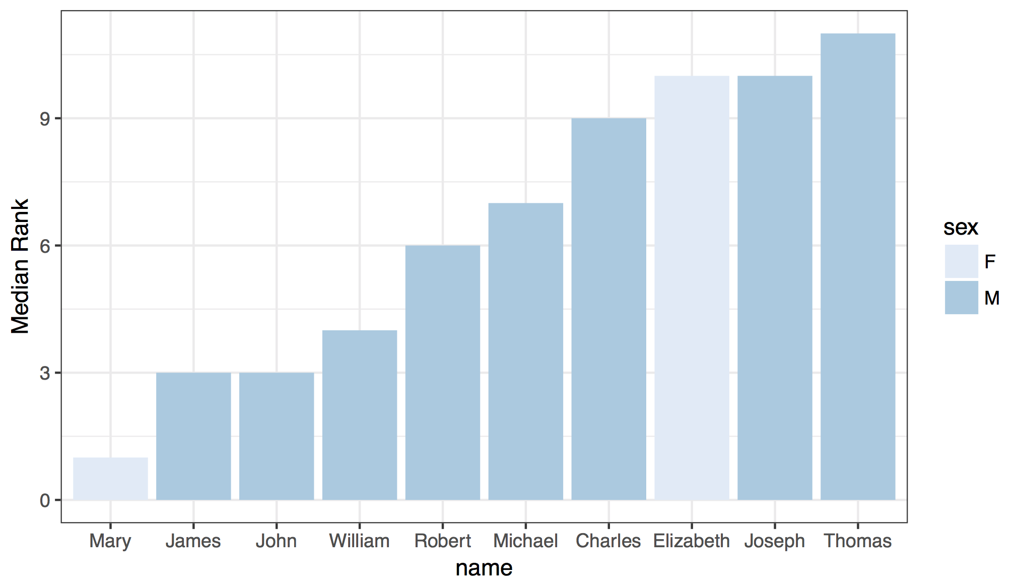
CC BY-SA RStudio

Slide 116
babynames %>%
group_by(year, sex) %>%
mutate(rank = min_rank(desc(prop))) %>%
group_by(name, sex) %>%
summarise(score = median(rank)) %>%
ungroup() %>%
arrange(score) %>%
slice(1:10) %>%
ggplot() +
geom_col(mapping = aes(x = fct_reorder(name, score), y = score, fill = sex)) +
theme_bw() +
scale_fill_brewer() +
labs(x = "name", y = "Median Rank")
CC BY-SA RStudio

Slide 117
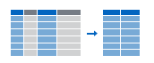
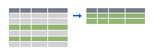
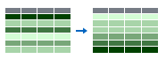
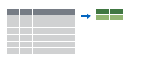
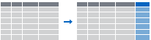
Recap: Single table verbs
Extract variables with select()
Extract cases with filter()
Arrange cases, with arrange().
Make tables of summaries with summarise().
Make new variables, with mutate().
CC BY-SA RStudio

Slide 118
Joining Datasets

Slide 119
nycflights13
Data about every flight that departed La Guardia, JFK, or Newark airports in 2013
❒
# install.packages("nycflights13")
library(nycflights13)
CC BY-SA RStudio

Slide 120
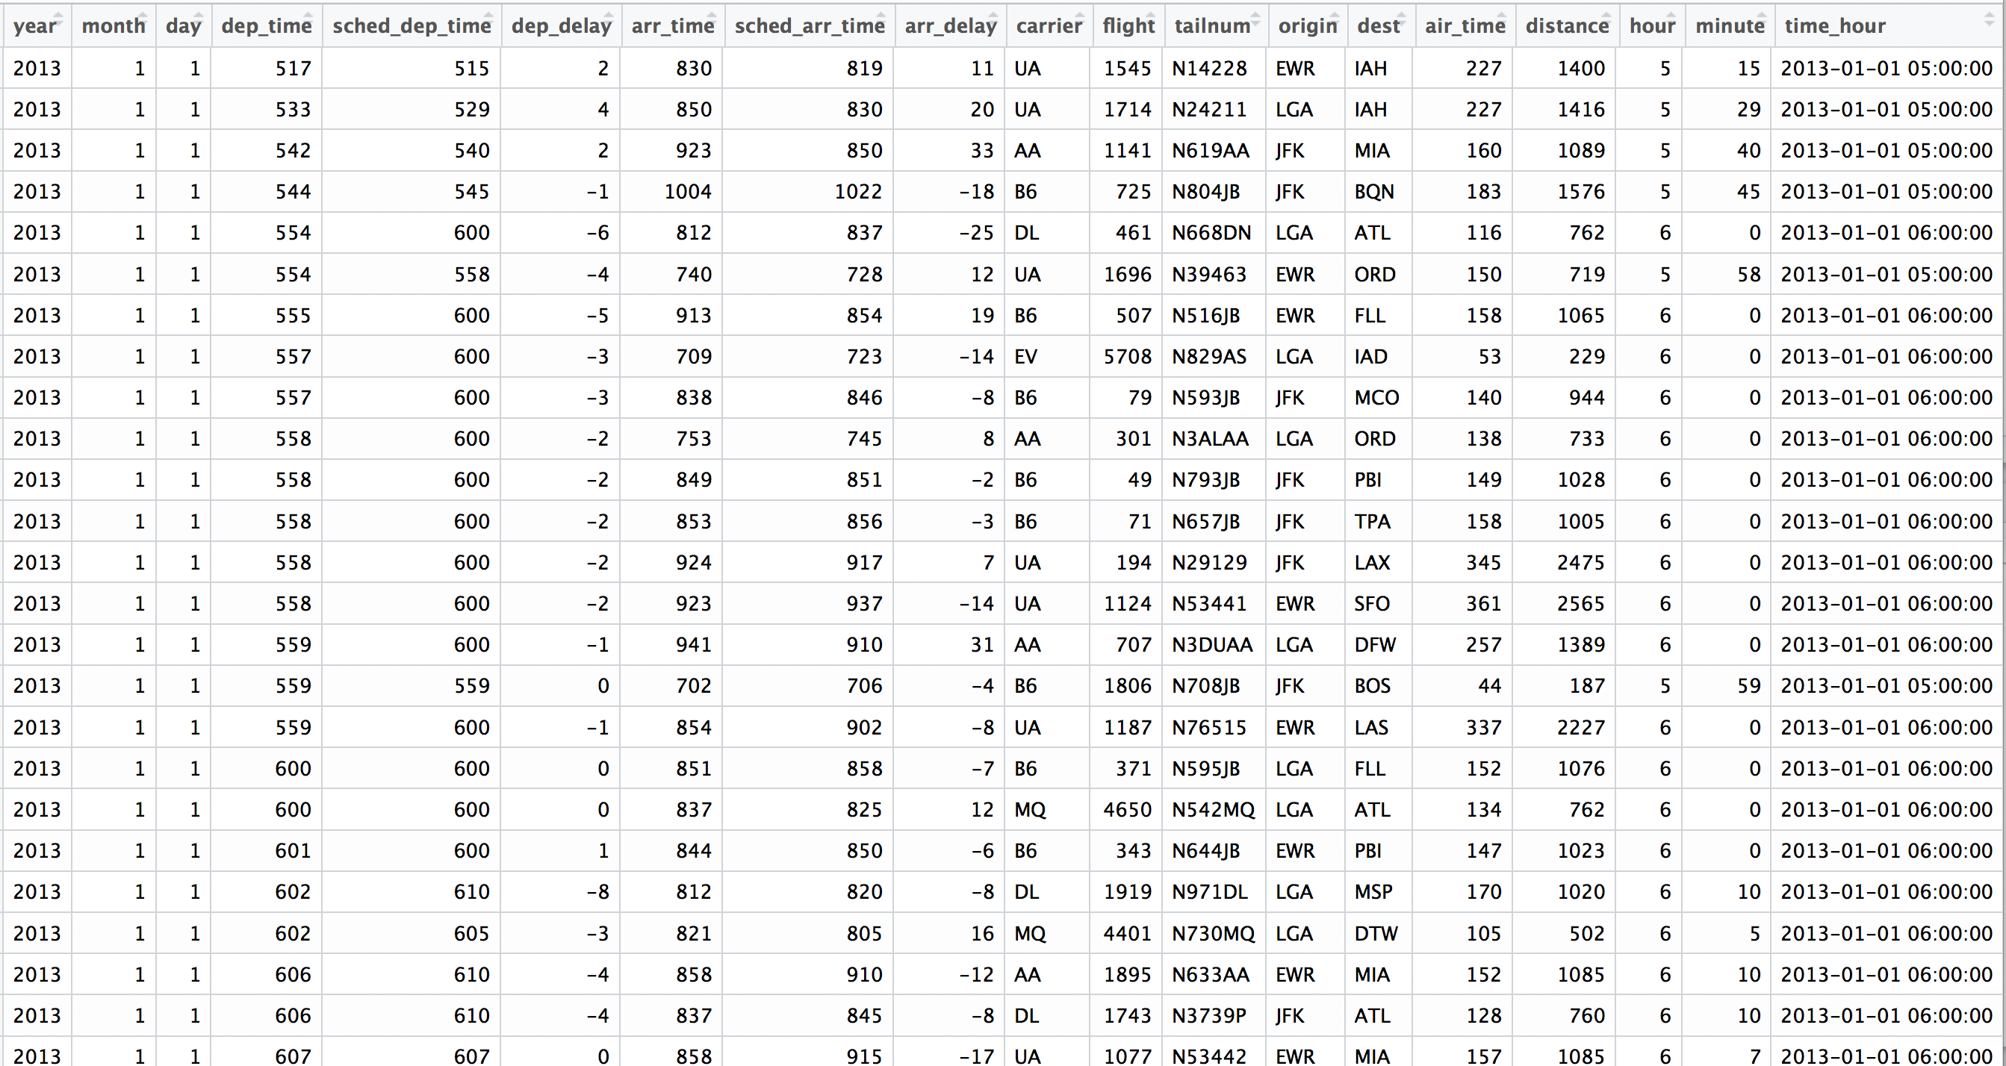
Flights
View(flights)
CC BY-SA RStudio

Slide 121
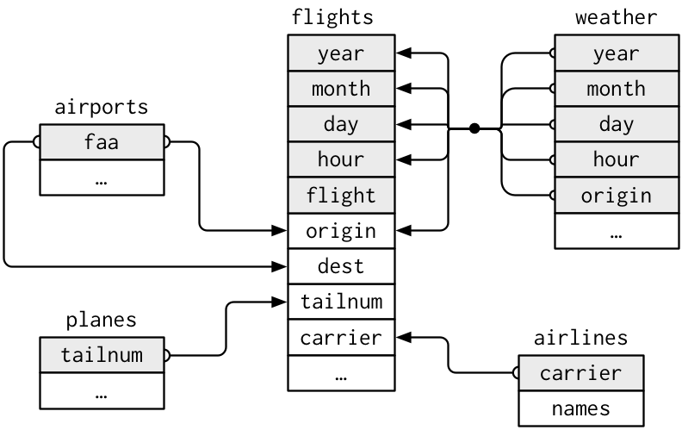
nycflights13
year
…
CC BY-SA RStudio

Slide 122
nycflights13
What airline had the longest delays?
year
…
CC BY-SA RStudio

Slide 123
nycflights13
What airline used the newest planes?
year
…
CC BY-SA RStudio

Slide 124
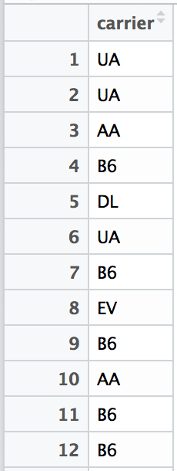
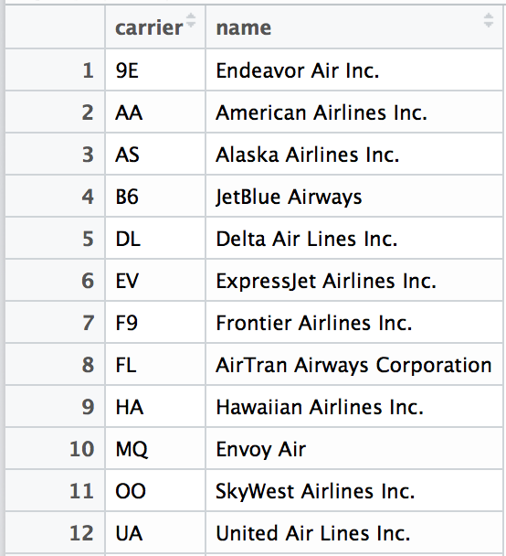
Airline names
View(flights["carrier"])
View(airlines)
CC BY-SA RStudio

Slide 125
mutating joins

Slide 126
common syntax
Each join function returns a data frame / tibble.
left_join(x, y, by = NULL, … )
join function
data frames to join
names of columns to join on
CC BY-SA RStudio

Slide 127
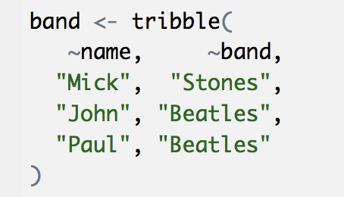
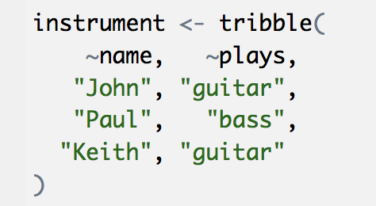
Toy data
band
name | band
Mick | Stones
John | Beatles
Paul | Beatles
instrument
instrument2 <- tribble(
~artist, ~plays,
"John", "guitar",
"Paul", "bass",
"Keith", "guitar"
)
name | plays
John | guitar
Paul | bass
Keith | guitar
CC BY-SA RStudio

Slide 128
Toy data
band
instrument
name | band
Mick | Stones
John | Beatles
Paul | Beatles
name | plays
John | guitar
Paul | bass
Keith | guitar
CC BY-SA RStudio

Slide 129
left
band %>% left_join(instrument, by = "name")
band
instrument
name | band
Mick | Stones
John | Beatles
Paul | Beatles
name | plays
John | guitar
Paul | bass
Keith | guitar
name | band | plays
Mick | Stones | <NA>
John | Beatles | guitar
Paul | Beatles | bass
+
=
CC BY-SA RStudio

Slide 130
right
band %>% right_join(instrument, by = "name")
band
instrument
name | band
Mick | Stones
John | Beatles
Paul | Beatles
name | plays
John | guitar
Paul | bass
Keith | guitar
name | band | plays
John | Beatles | guitar
Paul | Beatles | bass
Keith | <NA> | guitar
+
=
CC BY-SA RStudio

Slide 131
full
band %>% full_join(instrument, by = "name")
band
instrument
name | band
Mick | Stones
John | Beatles
Paul | Beatles
name | plays
John | guitar
Paul | bass
Keith | guitar
name | band | plays
Mick | Stones | <NA>
John | Beatles | guitar
Paul | Beatles | bass
Keith | <NA> | guitar
+
=
CC BY-SA RStudio

Slide 132
inner
band %>% inner_join(instrument, by = "name")
band
instrument
name | band
Mick | Stones
John | Beatles
Paul | Beatles
name | plays
John | guitar
Paul | bass
Keith | guitar
name | band | plays
John | Beatles | guitar
Paul | Beatles | bass
+
=
CC BY-SA RStudio

Slide 133
Airline names
View(flights["carrier"])
View(airlines)
CC BY-SA RStudio

Slide 134
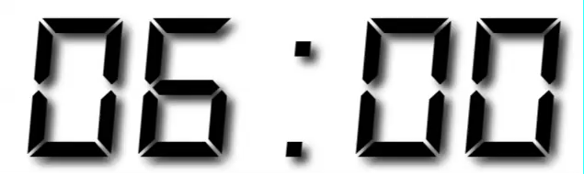
Your Turn 13
Which airlines had the largest arrival delays? Work in groups to complete the code below.
flights %>%
drop_na(arr_delay) %>%
%>%
group_by( ) %>%
%>%
arrange( )
1. Join airlines to flights
2. Compute and order the average arrival delays by airline. Display full names, no codes.

Slide 135
flights %>%
drop_na(arr_delay) %>%
left_join(airlines, by = "carrier") %>%
group_by(name) %>%
summarise(delay = mean(arr_delay)) %>%
arrange(delay)
## # A tibble: 16 × 2
## name delay
## <chr> <dbl>
## 1 Alaska Airlines Inc. -9.9308886
## 2 Hawaiian Airlines Inc. -6.9152047
## 3 American Airlines Inc. 0.3642909
## 4 Delta Air Lines Inc. 1.6443409
## 5 Virgin America 1.7644644
CC BY-SA RStudio

Slide 136
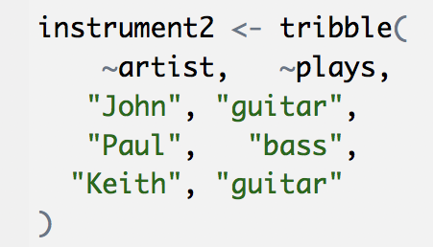
Toy data
band
name | band
Mick | Stones
John | Beatles
Paul | Beatles
instrument2
artist | plays
John | guitar
Paul | bass
Keith | guitar
CC BY-SA RStudio

Slide 137
What if the names do not match?
Use a named vector to match on variables with different names.
band %>% left_join(instrument2, by = c("name" = "artist"))
A named vector
The name of the element = the column name in the first data set
The value of the element = the column name in the second data set
CC BY-SA RStudio

Slide 138
common syntax - matching names
band %>% left_join(instrument2, by = c("name" = "artist"))
band
instrument2
name | band
Mick | Stones
John | Beatles
Paul | Beatles
artist | plays
John | guitar
Paul | bass
Keith | guitar
name | band | plays
Mick | Stones | <NA>
John | Beatles | guitar
Paul | Beatles | bass
+
=
CC BY-SA RStudio

Slide 139
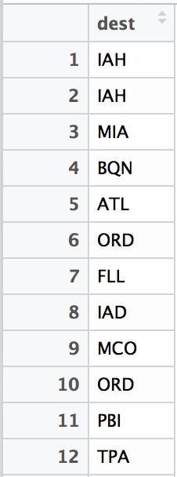
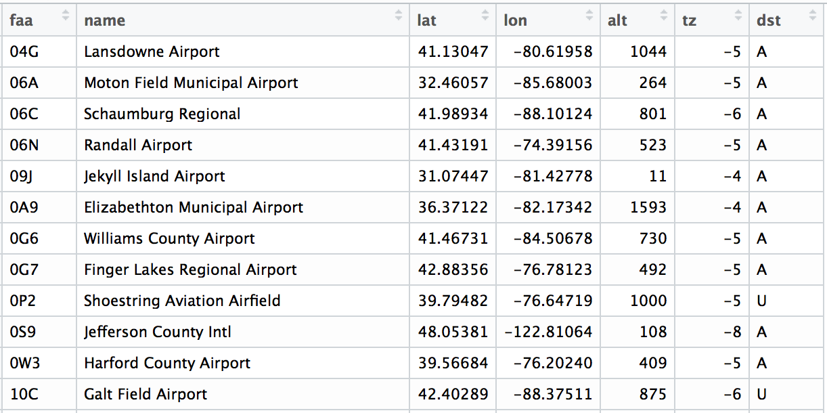
Airport names
View(flights["dest"])
View(airports)
CC BY-SA RStudio

Slide 140
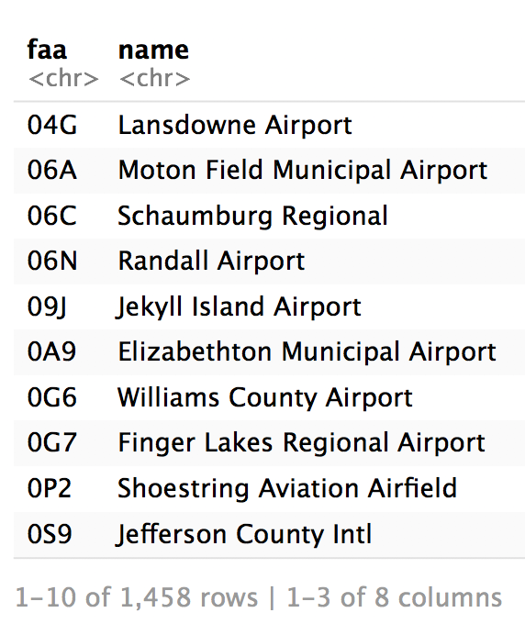
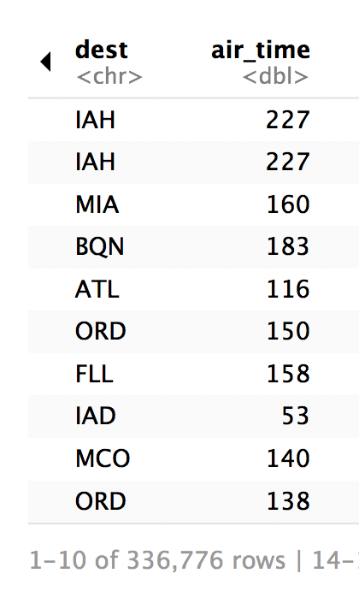
Airport names
airports %>% select(1:3)
flights %>% select(14:15)
CC BY-SA RStudio

Slide 141
common syntax - matching names
airports %>% left_join(flights, by = c("faa" = "dest"))
CC BY-SA RStudio

Slide 142
Your Turn 14
Use flights and airports to compute the distance and average arr_delay by destination airport (names only, not codes). Order by average delay, worst to best.
Hint: use first() to get distance.

Slide 143
flights %>%
drop_na(arr_delay) %>%
left_join(airports, by = c("dest" = "faa")) %>%
group_by(name) %>%
summarise(distance = first(distance),
delay = mean(arr_delay)) %>%
arrange(desc(delay))
## # A tibble: 101 × 3
## name distance delay
## <chr> <dbl> <dbl>
## 1 Columbia Metropolitan 602 41.76415
## 2 Tulsa Intl 1215 33.65986
## 3 Will Rogers World 1325 30.61905
CC BY-SA RStudio

Slide 144
filtering joins

Slide 145
filtering joins
Mutating joins use information from one data set to add variables to another data set (like mutate())
Filtering joins use information from one data set to extract cases from another data set (like filter())
CC BY-SA RStudio

Slide 146
semi
band %>% semi_join(instrument, by = "name")
band
instrument
name | band
Mick | Stones
John | Beatles
Paul | Beatles
name | plays
John | guitar
Paul | bass
Keith | guitar
name | band
John | Beatles
Paul | Beatles
+
=
CC BY-SA RStudio

Slide 147
anti
band %>% anti_join(instrument, by = "name")
band
instrument
name | band
Mick | Stones
John | Beatles
Paul | Beatles
name | plays
John | guitar
Paul | bass
Keith | guitar
name | band
Mick | Stones
+
=
CC BY-SA RStudio

Slide 148
Airport names
airports %>% select(1:3)
flights %>% select(14:15)
CC BY-SA RStudio

Slide 149
Your Turn 14
How many airports in airports are serviced by flights originating in New York (i.e. flights in our dataset?)
Notice that the column to join on is named faa in the airports dataset and dest in the flights dataset.

Slide 150
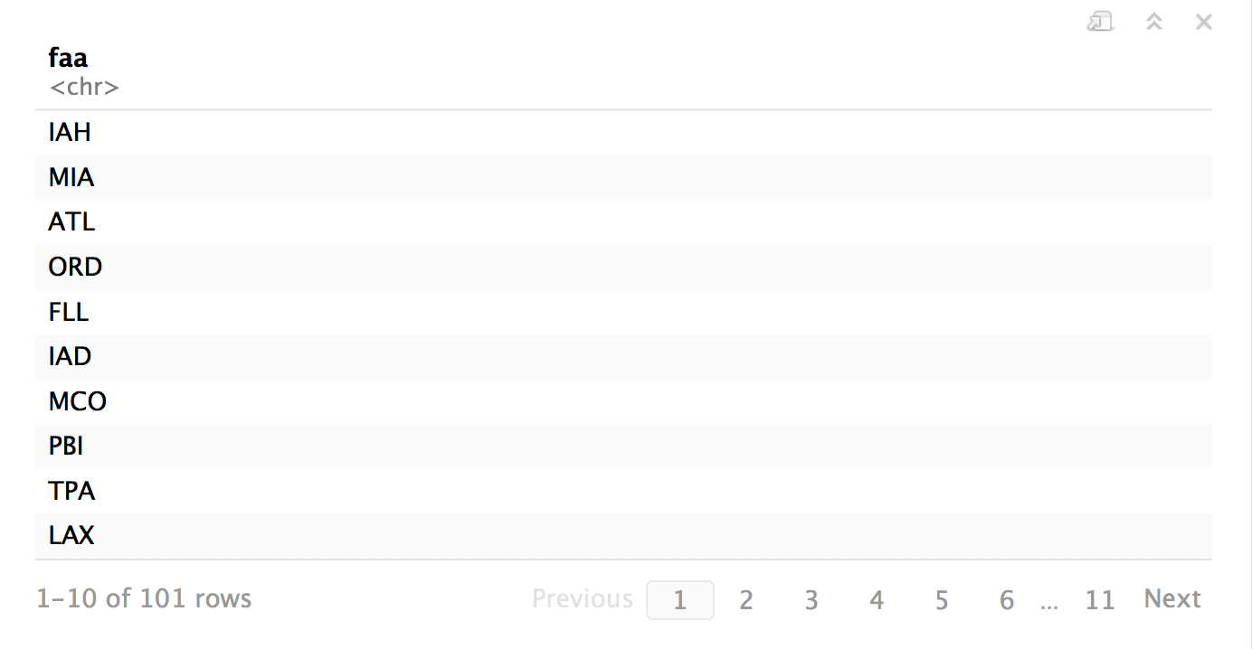
airports %>%
semi_join(flights, by = c("faa" = "dest")) %>%
distinct(faa)
CC BY-SA RStudio

Slide 151
distinct()
Removes rows with duplicate values (in a column).
distinct(df, name)
df
name | band
Mick | Stones
John | Beatles
John | Zeppelin
name
Mick
John
CC BY-SA RStudio

Slide 152
distinct()
Removes rows with duplicate values (in a column).
distinct(instrument, plays)
instrument
name | plays
John | guitar
Paul | bass
Keith | guitar
plays
guitar
bass
CC BY-SA RStudio

Slide 153
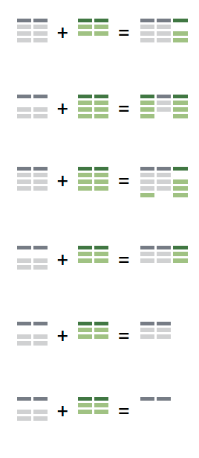
Recap: Two table verbs
left_join() retains all cases in left data set
right_join() retains all cases in right data set
full_join() retains all cases in either data set
inner_join() retains only cases in both data sets
semi_join() extracts cases that have a match
anti_join() extracts cases that do not have a match
CC BY-SA RStudio

Slide 154
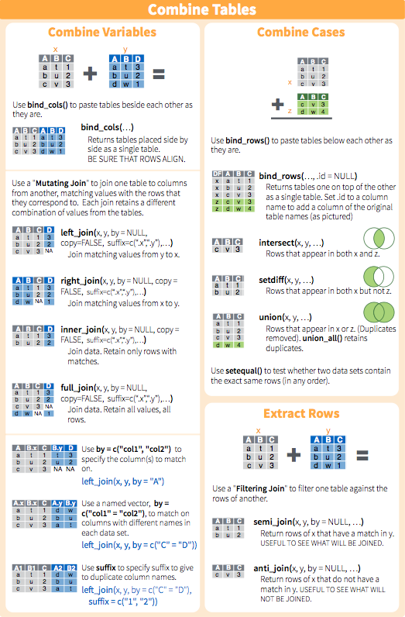
Two table verbs
CC BY-SA RStudio

Slide 155
dbplyr & SQL

Slide 156
SAS PROC SQL
PROC SQL;
create table baseline as
select PID, TREATTXT,
mean(MDRD) as MDRDBASE
from data
where VISWIN = 0
group by PID
order by TREATTXT;
QUIT;
CC BY-SA RStudio

Slide 157
SAS PROC SQL
R dplyr
PROC SQL;
create table baseline as
select PID, TREATTXT,
mean(MDRD) as MDRDBASE
from data
where VISWIN = 0
group by PID
order by TREATTXT;
QUIT;
baseline <- data %>%
filter(VISWIN == 0) %>%
group_by(PID) %>%
select(PID, TREATTXT, MDRD) %>%
mutate(MDRDBASE = mean(MDRD)) %>%
arrange(TREATTXT)
CC BY-SA RStudio

Slide 158
dbplyr & SQL
The dbplyr package takes dplyr functions and converts statements to SQL so that these can be applied as database queries.
Learn dplyr once, use it in many places…

Slide 159
CAUTION

Slide 160
This code won’t work – WHY NOT?
baseline <- data %>%
select(PID, TREATTXT, MDRD) %>%
filter(VISWIN == 0) %>%
group_by(PID) %>%
mutate(MDRDBASE = mean(MDRD)) %>%
arrange(TREATTXT)
CC BY-SA RStudio

Slide 161
dtplyr & data.table

Slide 162
data.table
BIG data wrangling package (5 – 50 Million rows)
Different syntax to dplyr. Yet another new thing to learn…

Slide 163
dtplyr
dtplyr package converts dplyr verbs into data.table equivalent.
Speeds up wrangling BIG data by 3x over using “standard” dplyr functions.
Learn dplyr once, use it in many places.

Slide 164
Tidy tools

Slide 165
Tidy tools
Functions are easiest to use when they are:
Simple - They do one thing, and they do it well
Composable - They can be combined with other functions for multi-step operations
Smart - They can use R objects as input.
Tidy functions do these things in a specific way.
CC BY-SA RStudio

Slide 166
1. Simple - They do one thing, and they do it well
filter() - extract cases
arrange() - reorder cases
group_by() - group cases
select() - extract variables
mutate() - create new variables
summarise() - summarise variables / create cases
CC BY-SA RStudio

Slide 167
2. Composable - They can be combined with other functions for multi-step operations
%>%
babynames mutate( , percent = prop * 100)
Each dplyr function takes a data frame as its first argument and returns a data frame. As a result, you can directly pipe the output of one function into the next.
CC BY-SA RStudio

Slide 168
3. Smart - They can use R objects as input.
TODO: Dplyr functions use non-standard evaluation, which means that you cannot simply pass an R object.
CC BY-SA RStudio

Slide 169
babynames %>% filter(n > 500)
These objects are looked up in babynames
These objects are looked up in the scope of x
x <- n > 500
babynames %>% filter(x) # ERROR!
CC BY-SA RStudio

